Slide 1
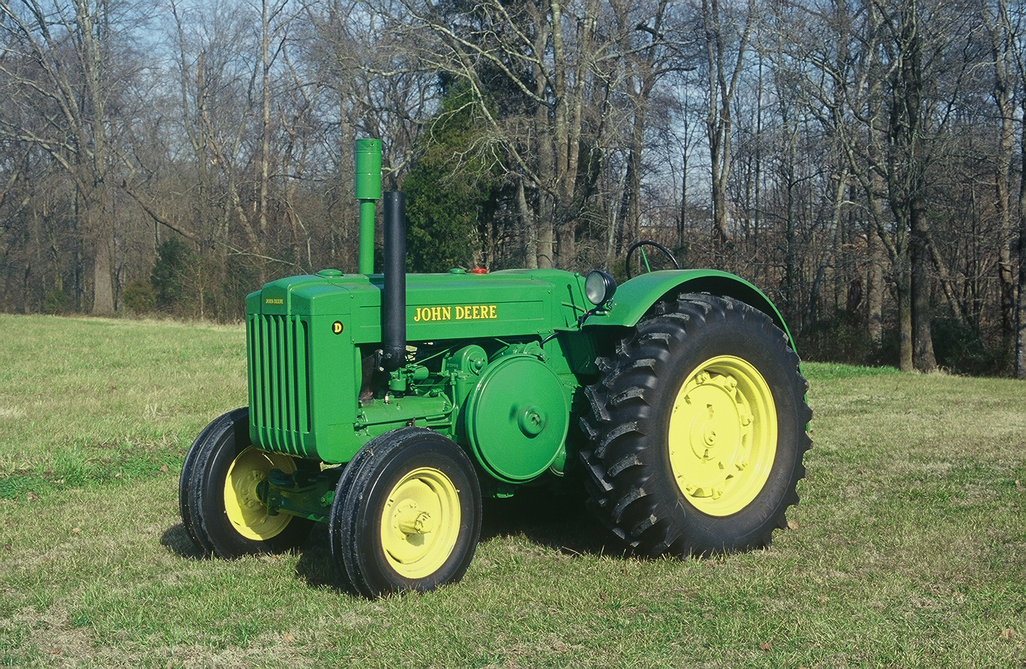

Slide 2
NORTH CAROLINA
COUNCIL OF CHAPTERS OF MOAA
HARLEY ELLINGER 3dVP
NEW BERN, NC
JANUARY 17, 2015
Ist QUARTER MEETING – 2015
LEGISLATIVE REPORT

Slide 3


Slide 4


Slide 5
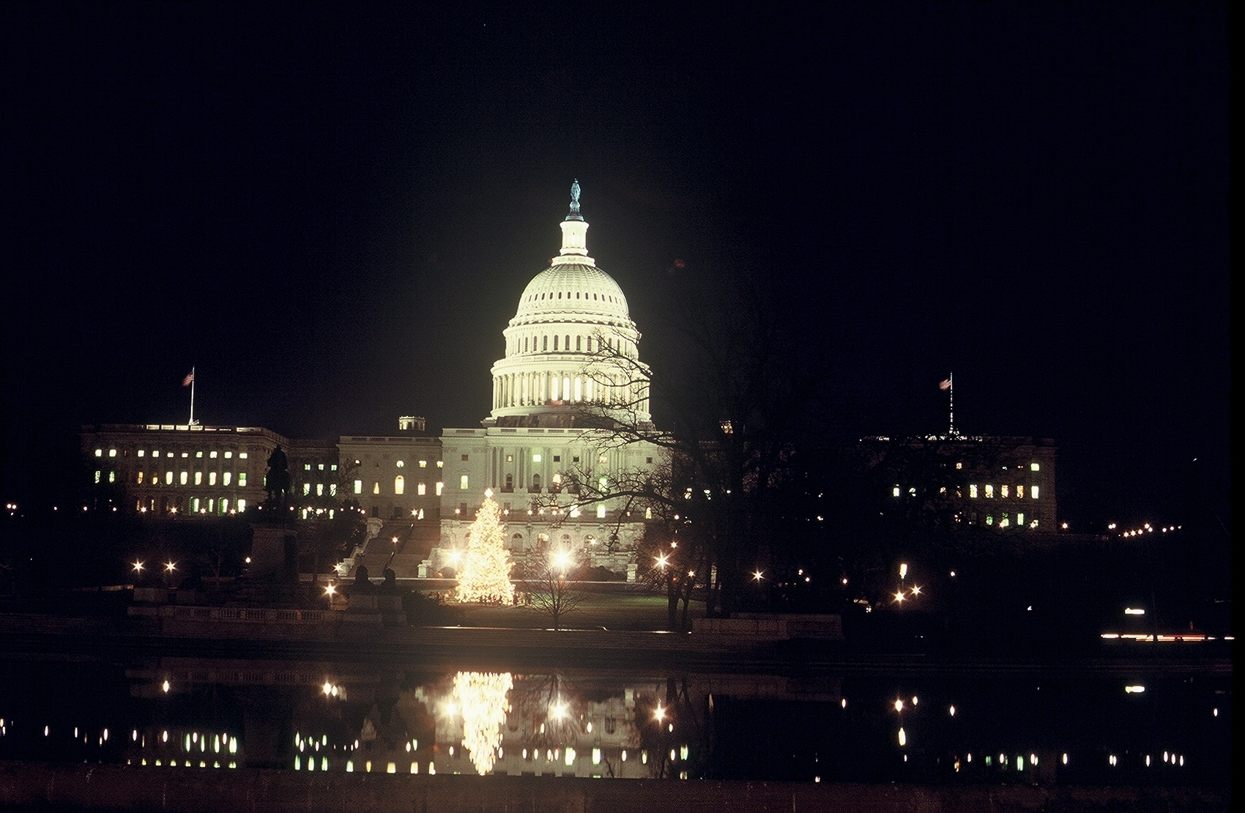

Slide 6
NATIONAL ISSUES
ONLY 4% OF ALL LIVING
AMERICANS
HAVE SERVED IN THE MILITARY

Slide 7
NATIONAL ISSUES
REPUDIATION OF TRUMAN DOCTRINE
1. Intervene early – Post WW11 (1945-1950).
2. Fight the battles overseas.
WHY DO WE NEED A STRONG MILITARY?
1. We have Homeland Security.
2. We have the CIA & FBI & POLICE.

Slide 8
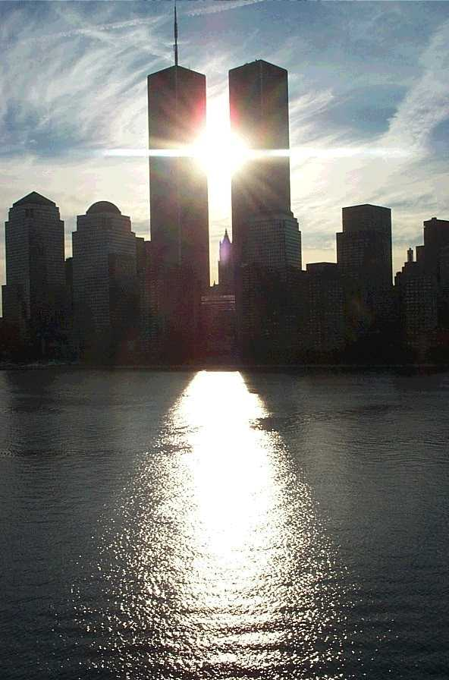

Slide 9
NATIONAL ISSUES
FUTURE FORECAST:
“A rising tide of threats to military personnel
programs could turn into concrete proposals
gut compensation and benefits.”

Slide 10
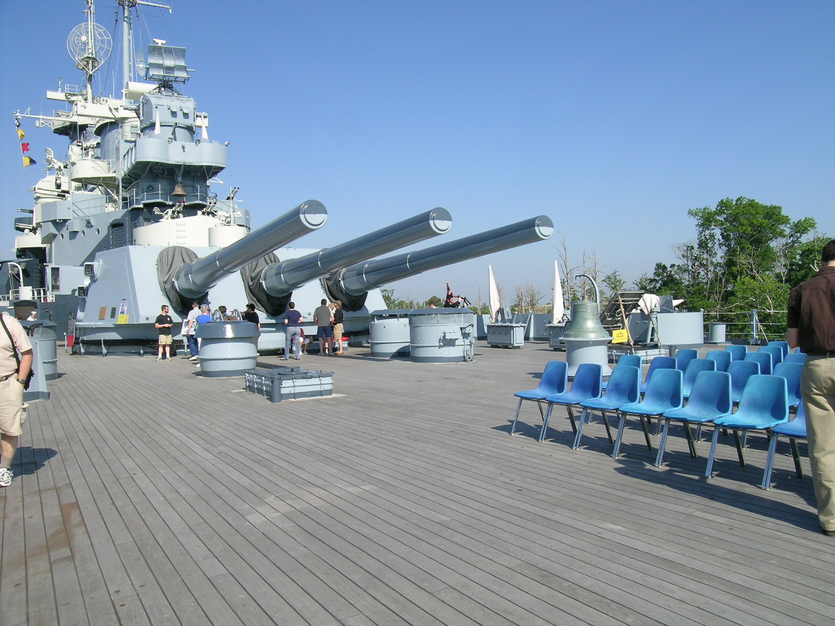

Slide 11
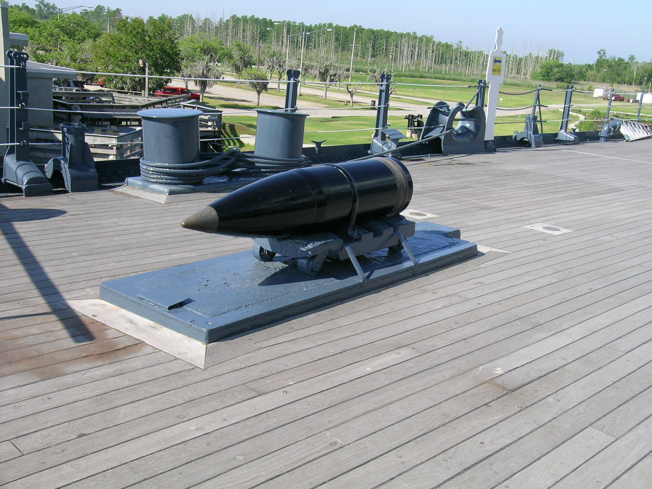

Slide 12
NATIONAL MOAA ISSUES - 2015
FORCE/FAMILY ISSUES:
Force size = mission requirements
Military pay comparable to private sector
Protect benefits from sequestration cuts
Create and preserve benefits for Reserve
& National guard members.
Protect family support programs – exchanges,
commissaries, and dependent schools.

Slide 13
NATIONAL MOAA ISSUES - 2015
HEALTH CARE ISSUES
Avert Medicare/TRICARE 24% cut in payments
Oppose means testing for life enrollment fees
for TRICARE.
Block TRICARE consolidation of health plans
Increase orthodontic pay cap
Protect VA health care budgets

Slide 14
NATIONAL MOAA ISSUES - 2015
RETIREMENT/SURVIVOR ISSUES
Evaluate Mil. Comp. Commission Rec.
Oppose Mil. Benefit changes inconsistent
with service career sacrifices
Preserve full inflation COLAs
End deduction of VA disability compensation
from military pay

Slide 15
NATIONAL MOAA ISSUES - 2015
VETERANS/OTHER ISSUES
Eliminate VA claims backlog/improve system.
Improve VA healthcare services.
Extend caregiver services to all qualifying
disabled veterans.
Authorize pre-tax payment of health, dental,
and long-term health care premiums.

Slide 16
MOAA’s TOP TEN GOALS - 2015
1. Sustain military pay with private sector.
2. Block erosion of housing/commissary ben.
3. Bar TRICARE disproportional fee hikes.
4. Prevent Medicare/TRICARE cuts.
5. Protect military retirement/COLAs
6. Sustain wounded warrior programs
7. End disabled/survivor finance penalties

Slide 17
MOAA’s TOP TEN GOALS - 2015
8. Fix guard/reserve retirement.
9. Improve spouse and family support.
10. Assure timely access to VA & eliminate
VA the claims backlog.

Slide 18
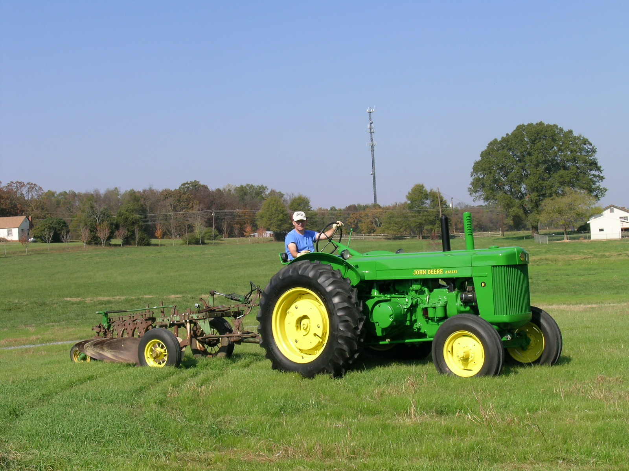

Slide 19
STATE ISSUES
PRESIDENT
COL JERI GRAHAM

